Slide 1
Let’s Get Camping-Planning for Summer 2022
High Adventure Opportunities

Slide 2

LENHOK’SIN HIGH ADVENTURE
Backpacking and Canoeing Trek Camp
Goshen Scout Reservation

Slide 3
What is Lenhok’sin?
NCAC’s very own High Adventure Camp
A part of the Goshen Scout Reservation
  Goshen, Virginia
  Located at “Camp Baird”
Over 4,000 acres of GSR Land
  Surrounded by 35,000 acres of state game land
Two featured treks:
  Backpacking Trek
  Canoeing Trek

Slide 4
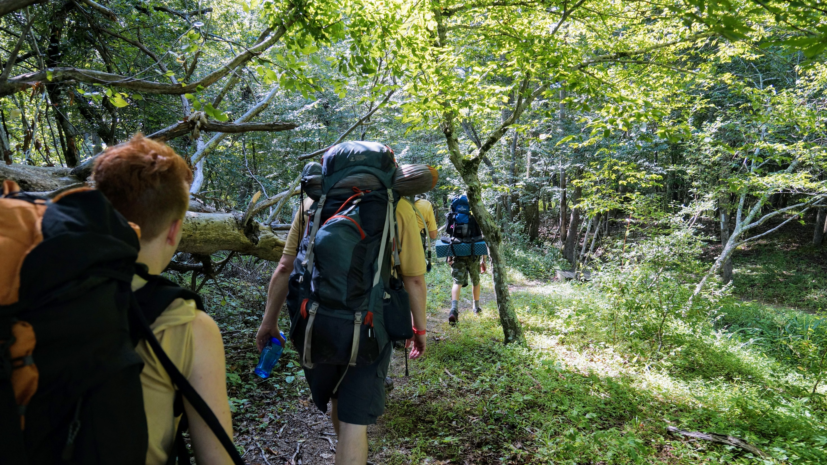
Backpacking Trek

Slide 5
Backpacking Trek
“Plan Your Own Adventure”
  Personally tailor your route to fit your unit’s level of experience and goals
  Complete pre-trek survey before arriving at camp
Five days and four nights on the trail
Sunday: Arrive at Basecamp
Friday: Return to basecamp
Monday: Hit the trail!
Saturday: On to the next adventure!

Slide 6
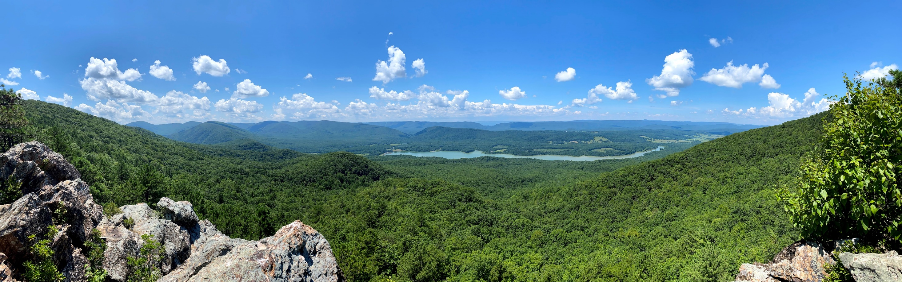
Viewing Rock

Slide 7
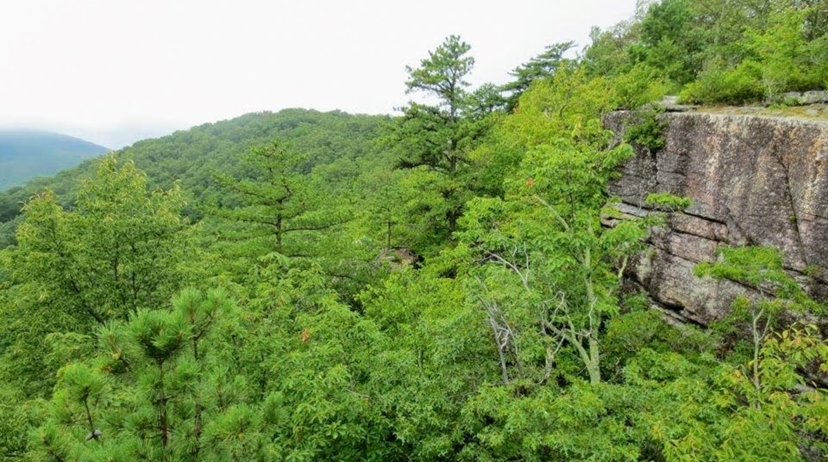
Forge Mountain

Slide 8
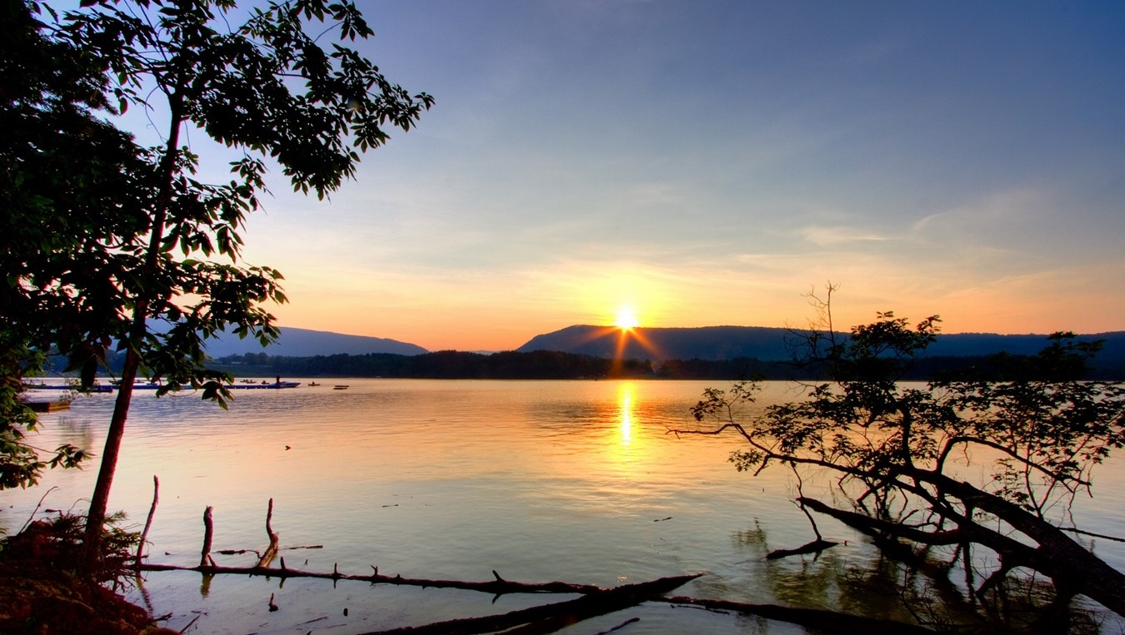
Lake Merriweather

Slide 9
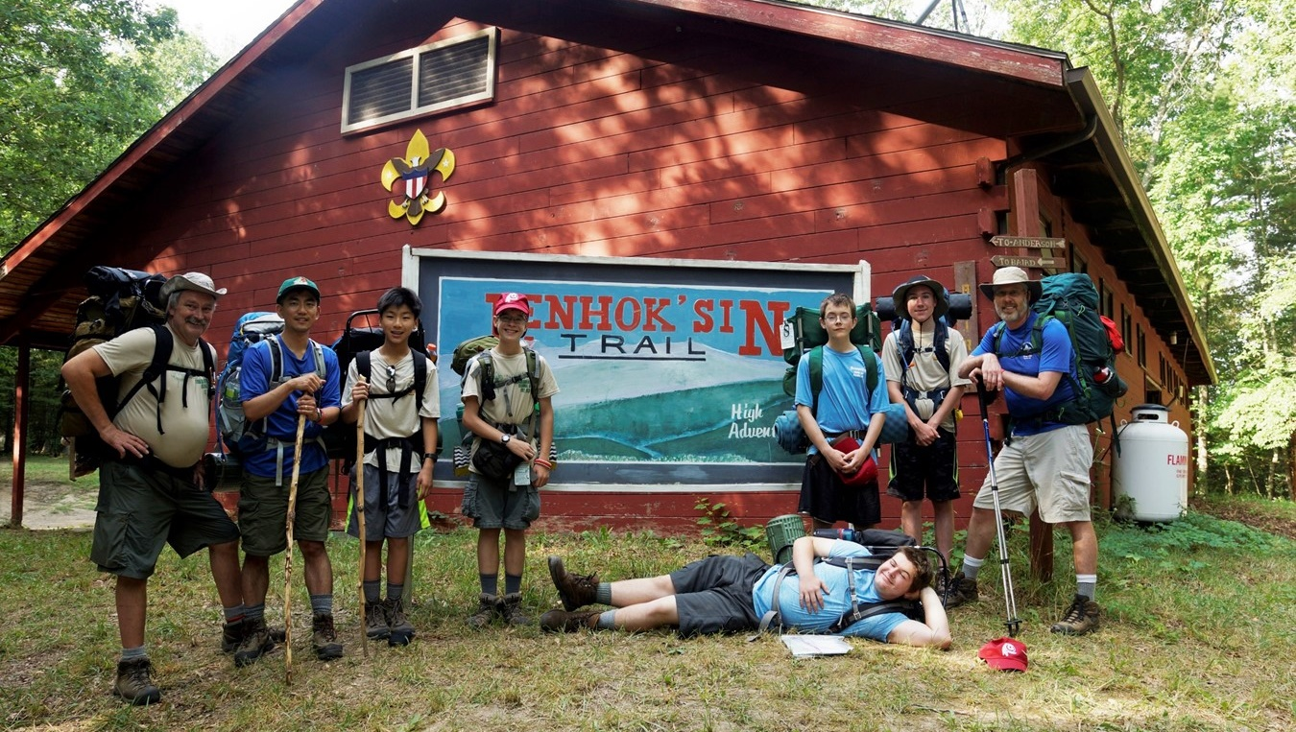
This Could Be You!

Slide 10
Lenhok’sin Outposts
Historical
Technical
Mountain Man
Foxfire
Wood’s Edge (formerly Robin Hood)
Aquatics
Caving
COPE (Challenging Outdoor Personal Experience)
Search and Rescue
Primitive Night

Slide 11
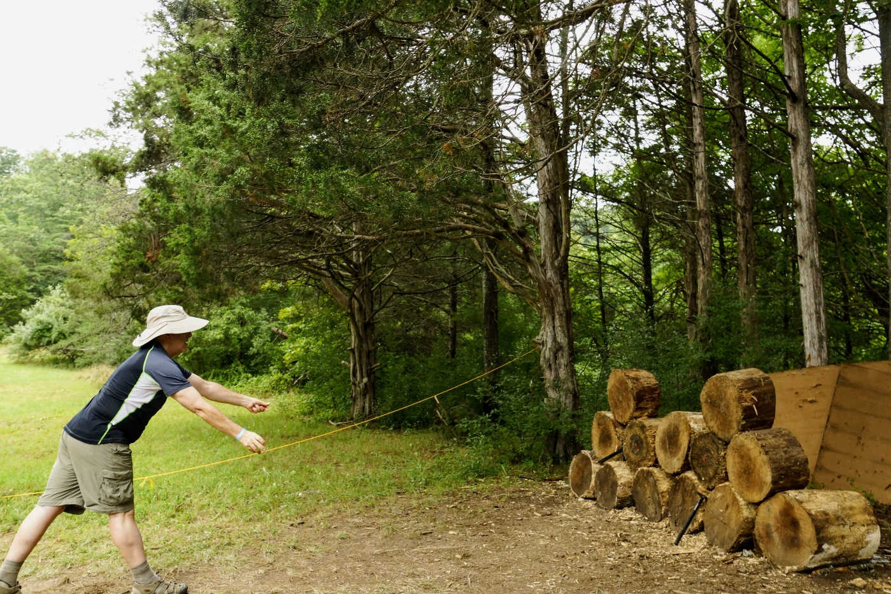
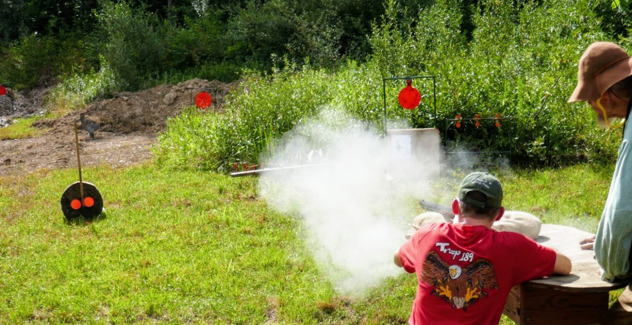
Mountain Man
19th Century Mountain Man Encampment
Black Powder Muzzle Loading Rifles
Tomahawk Throwing
Bartering with the Mountain Men

Slide 12
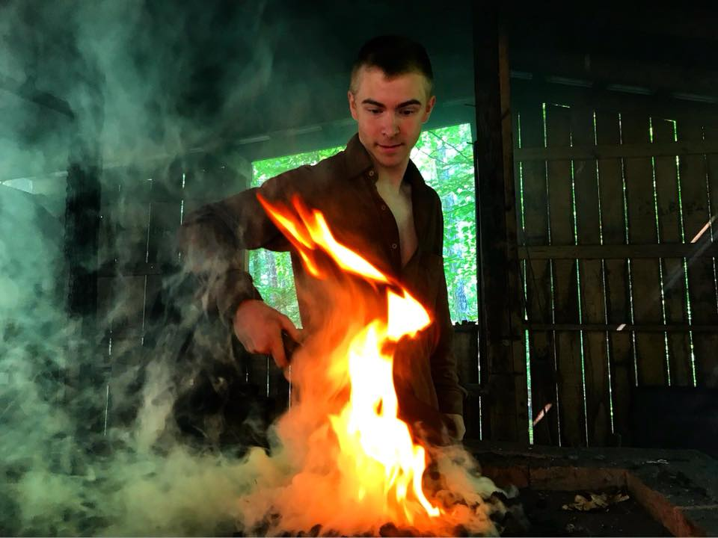
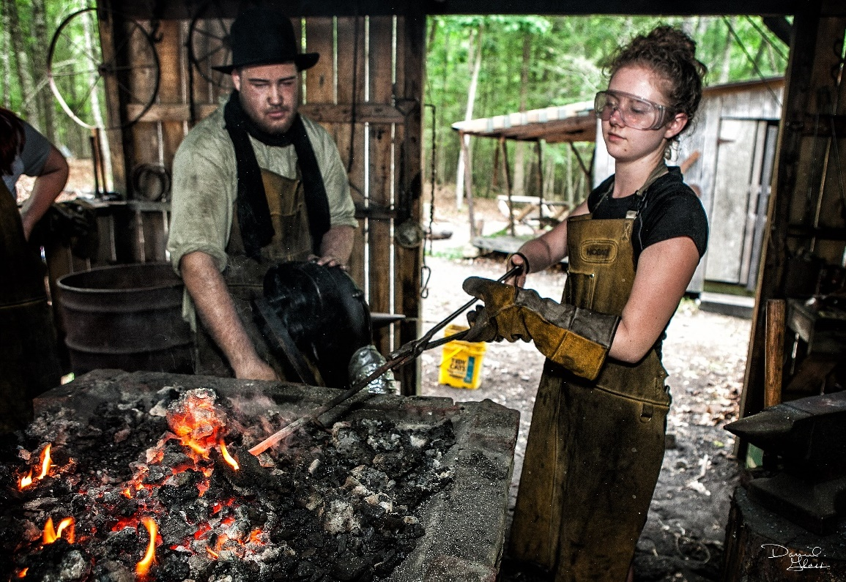
Foxfire
20th Century Appalachian Blacksmithing Forge
  Forge your own “S” and “J” hooks, knife blades
Branding
Bullet Casting
Candle Making
Kelso Spring
  Wading in the freshwater spring

Slide 13
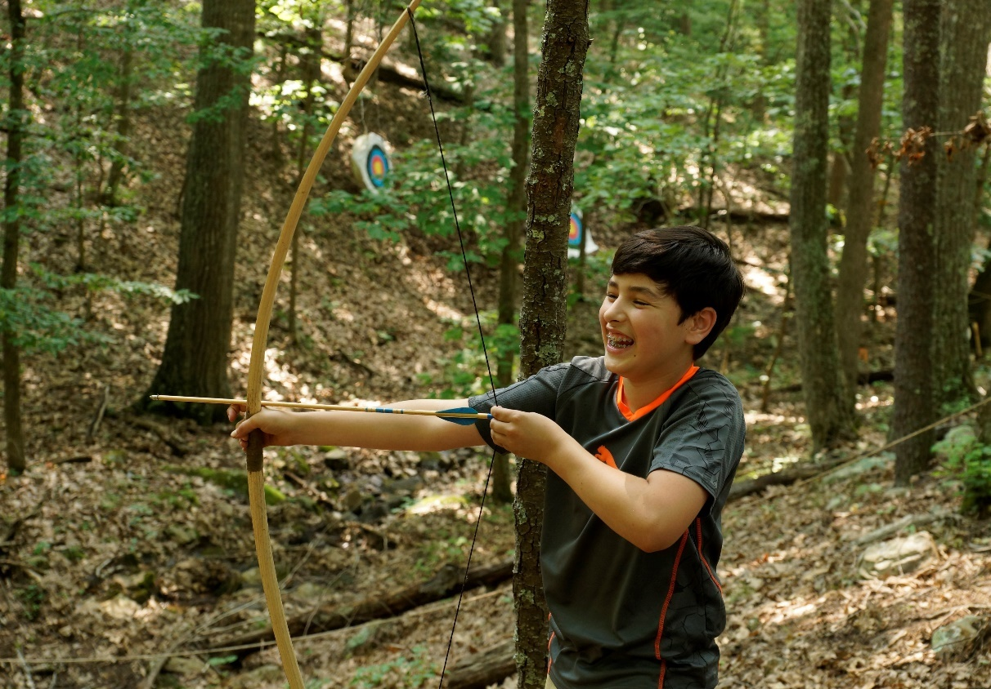
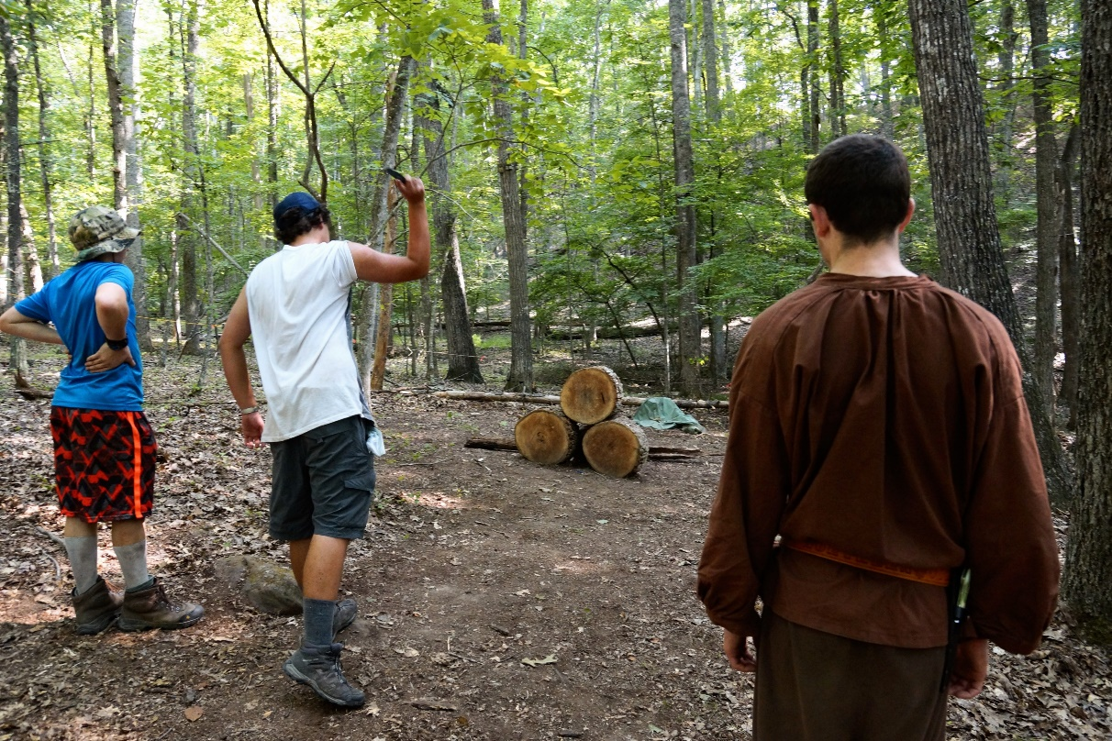
Wood’s Edge
Medieval Homestead
Archery
Dagger Throwing
Survivalist Skills
Dutch Oven Cooking

Slide 14
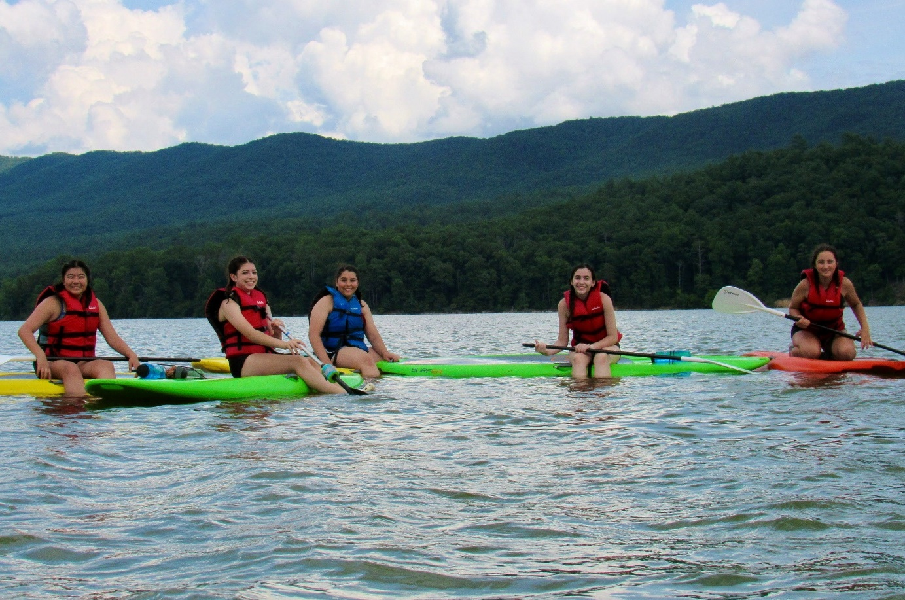
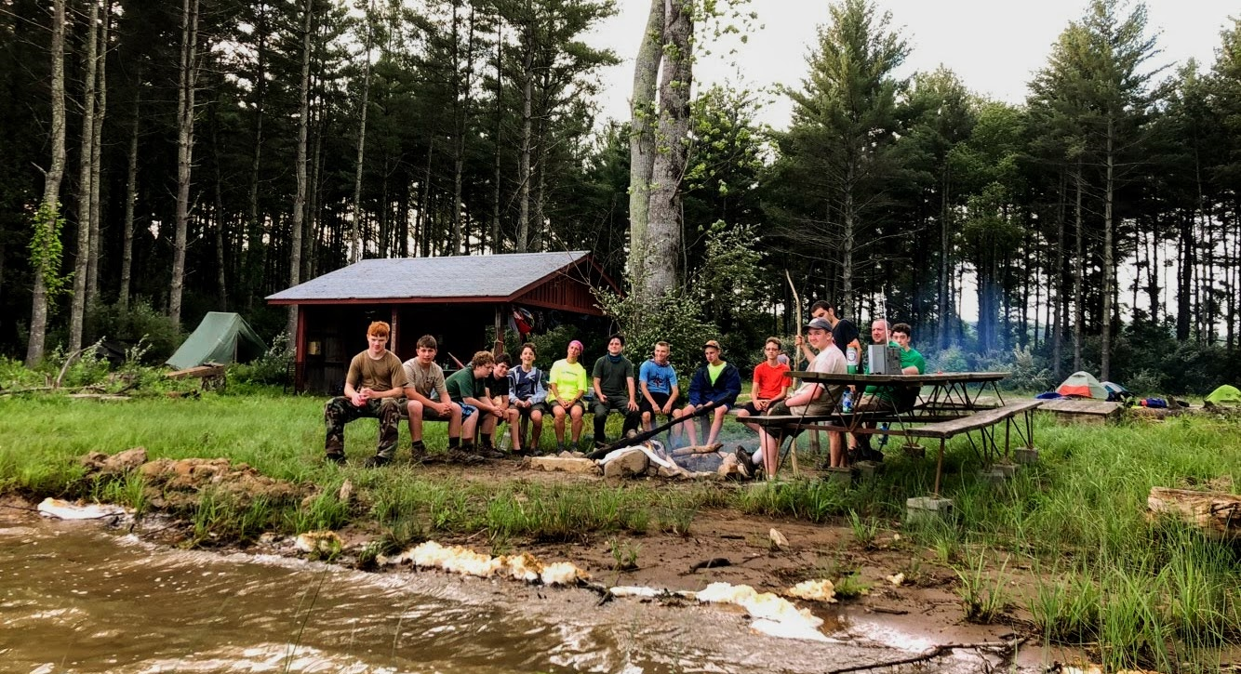
Aquatics
Stand Up Paddle Boarding
Kayaking
Free Swim Area
450 Acre Lake

Slide 15
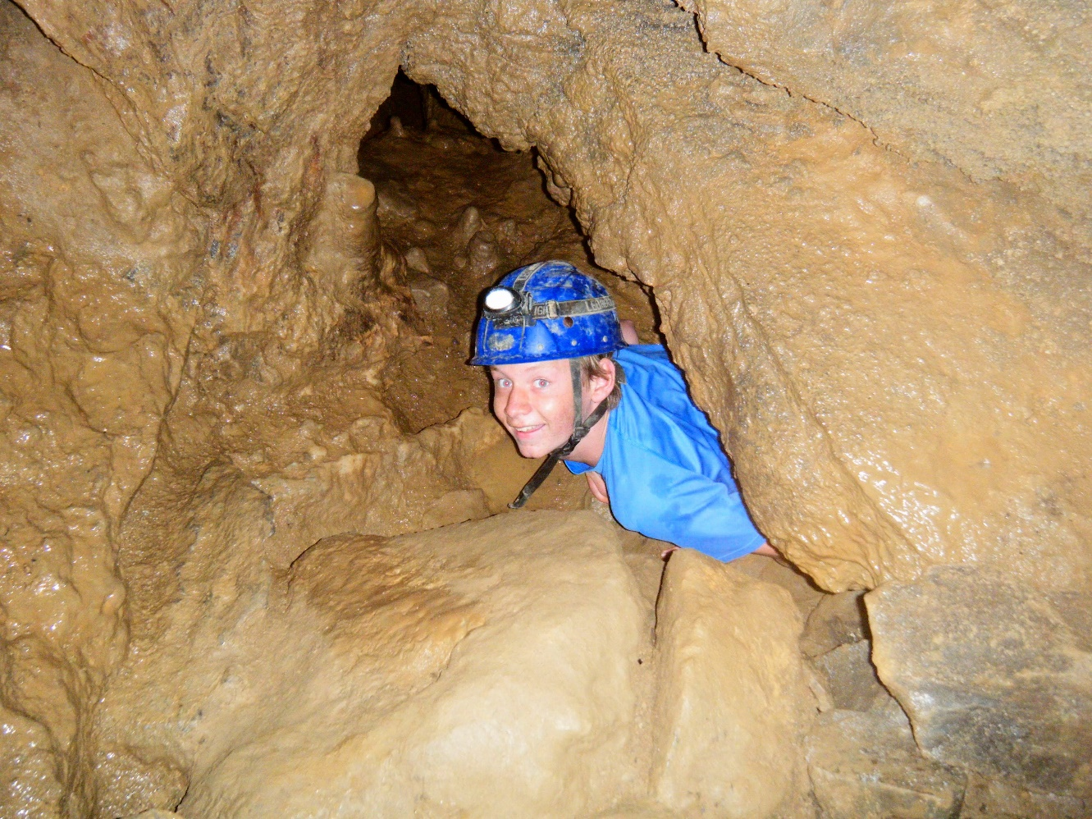
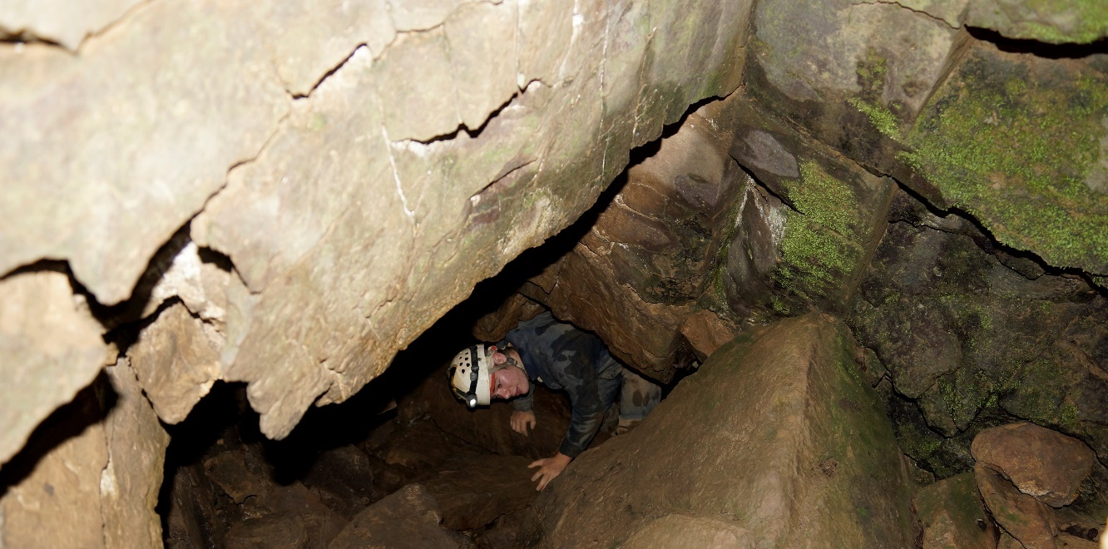
Caving (Closed for Summer 2022)
Over 3 miles of Cave System
Cave Exploration/Spelunking
Cave Science

Slide 16
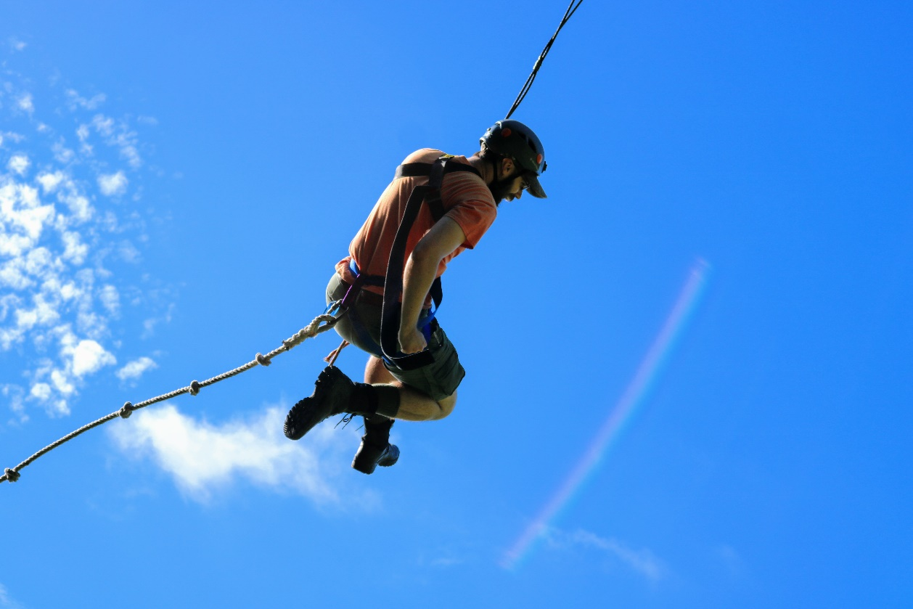
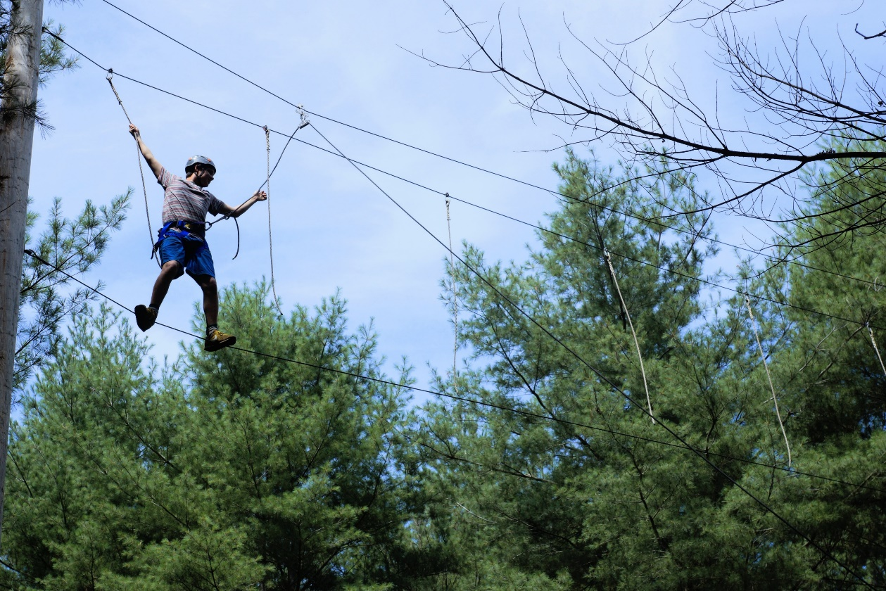
COPE (Challenging Outdoor Personal Experience)
Team Building Exercises
Low and Medium Elements
High Ropes Elements

Slide 17
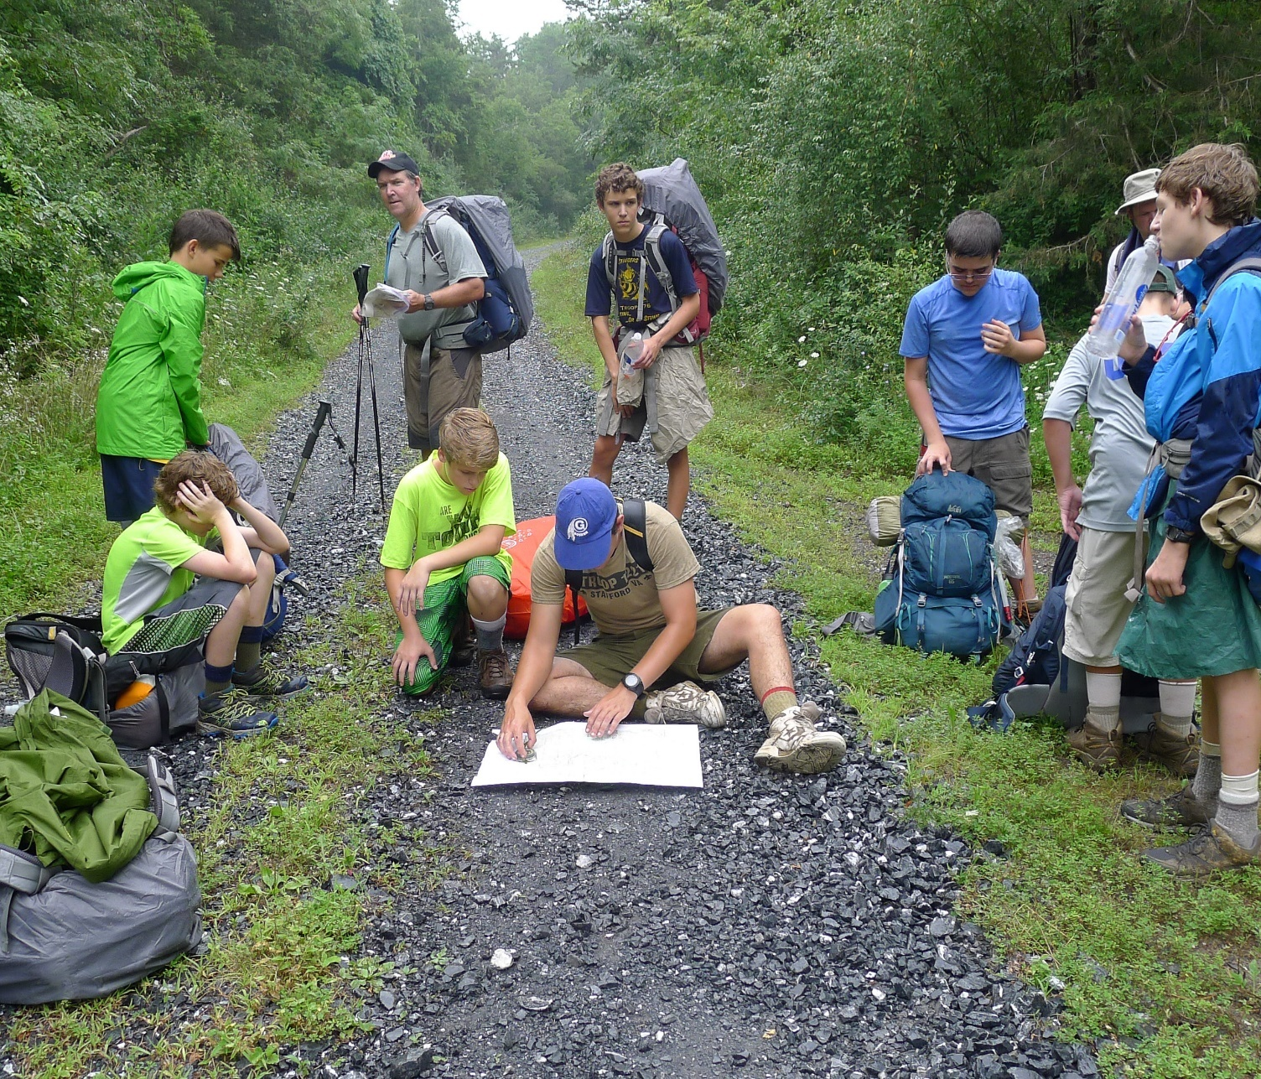
Search and Rescue (New!)
Staff-led SAR Scenarios
Gain introductory skills in
  Treating common backcountry injuries
  Responding to Environmental emergencies
Backcountry preparedness

Slide 18
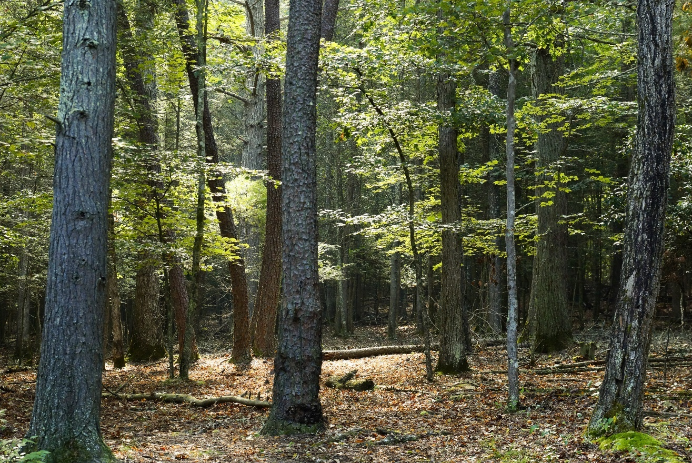
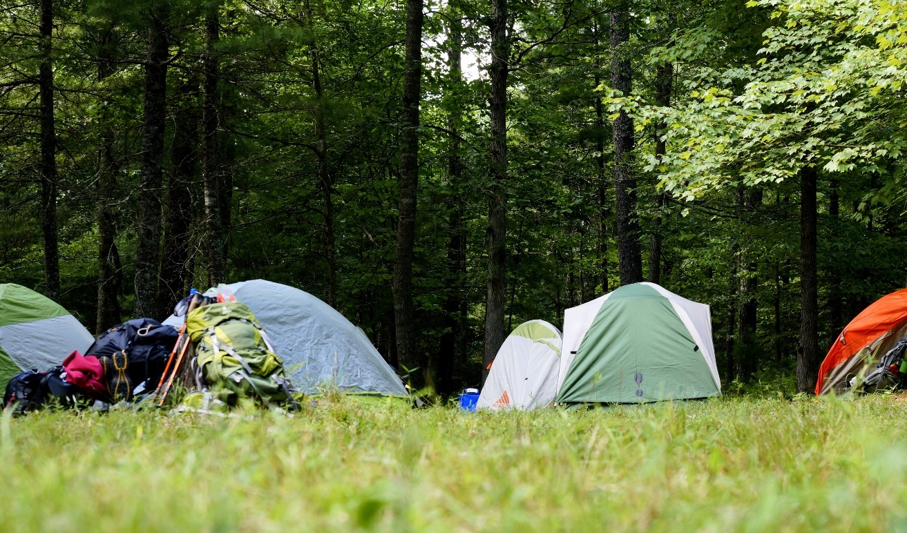
Primitive Camping
Opportunity for longer hiking days
Time to complete Kodiak Challenge
Time to work on merit badges and other award requirements
Immerse yourself in the Goshen wilderness

Slide 19
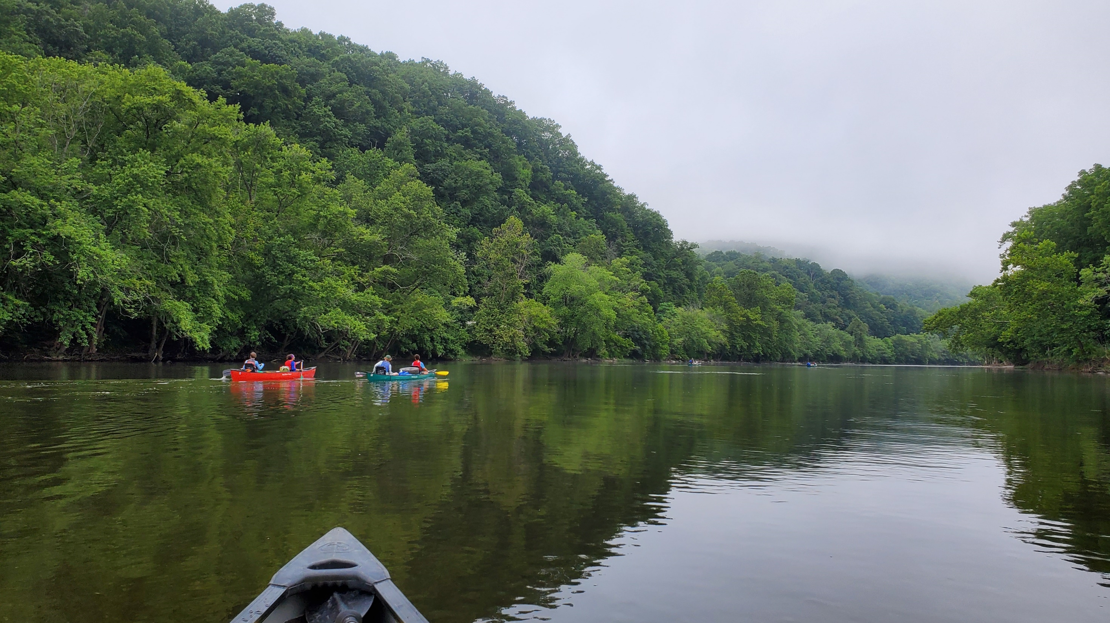
James River Canoe Trek
Chris Wilson, Crew 893, Centreville VA

Slide 20
James River Canoe Trek
Partnership with Twin River Outfitters
  Buchanan, VA
61+ miles of canoeing adventure (From the Iron Gate to Snowden Dam)
Over 100 class I rapids, and 20 challenging class II rapid
  Including infamous Balcony Falls rapid
Camping at public campgrounds along the way
Sunday: Arrive at Basecamp
Friday: Return to basecamp
Monday: Travel to Outfitter, Paddle Away
Saturday: On to the next adventure!
River Trek Leader's Guide

Slide 21
James River Canoe Trek
Lenhok’sin Staff Guide – first two days
Earn your 50 MILER Award - Truly one of the best river trips in the Mid Atlantic to get this award.
Experience tons of whitewater rapids!
Scenic views of the Blue Ridge Mountains (Upper James River Water Trail)
A wilderness experience (compared to more developed rivers)
No required portaging
Kayaking experience on the last day of your trek

Slide 22
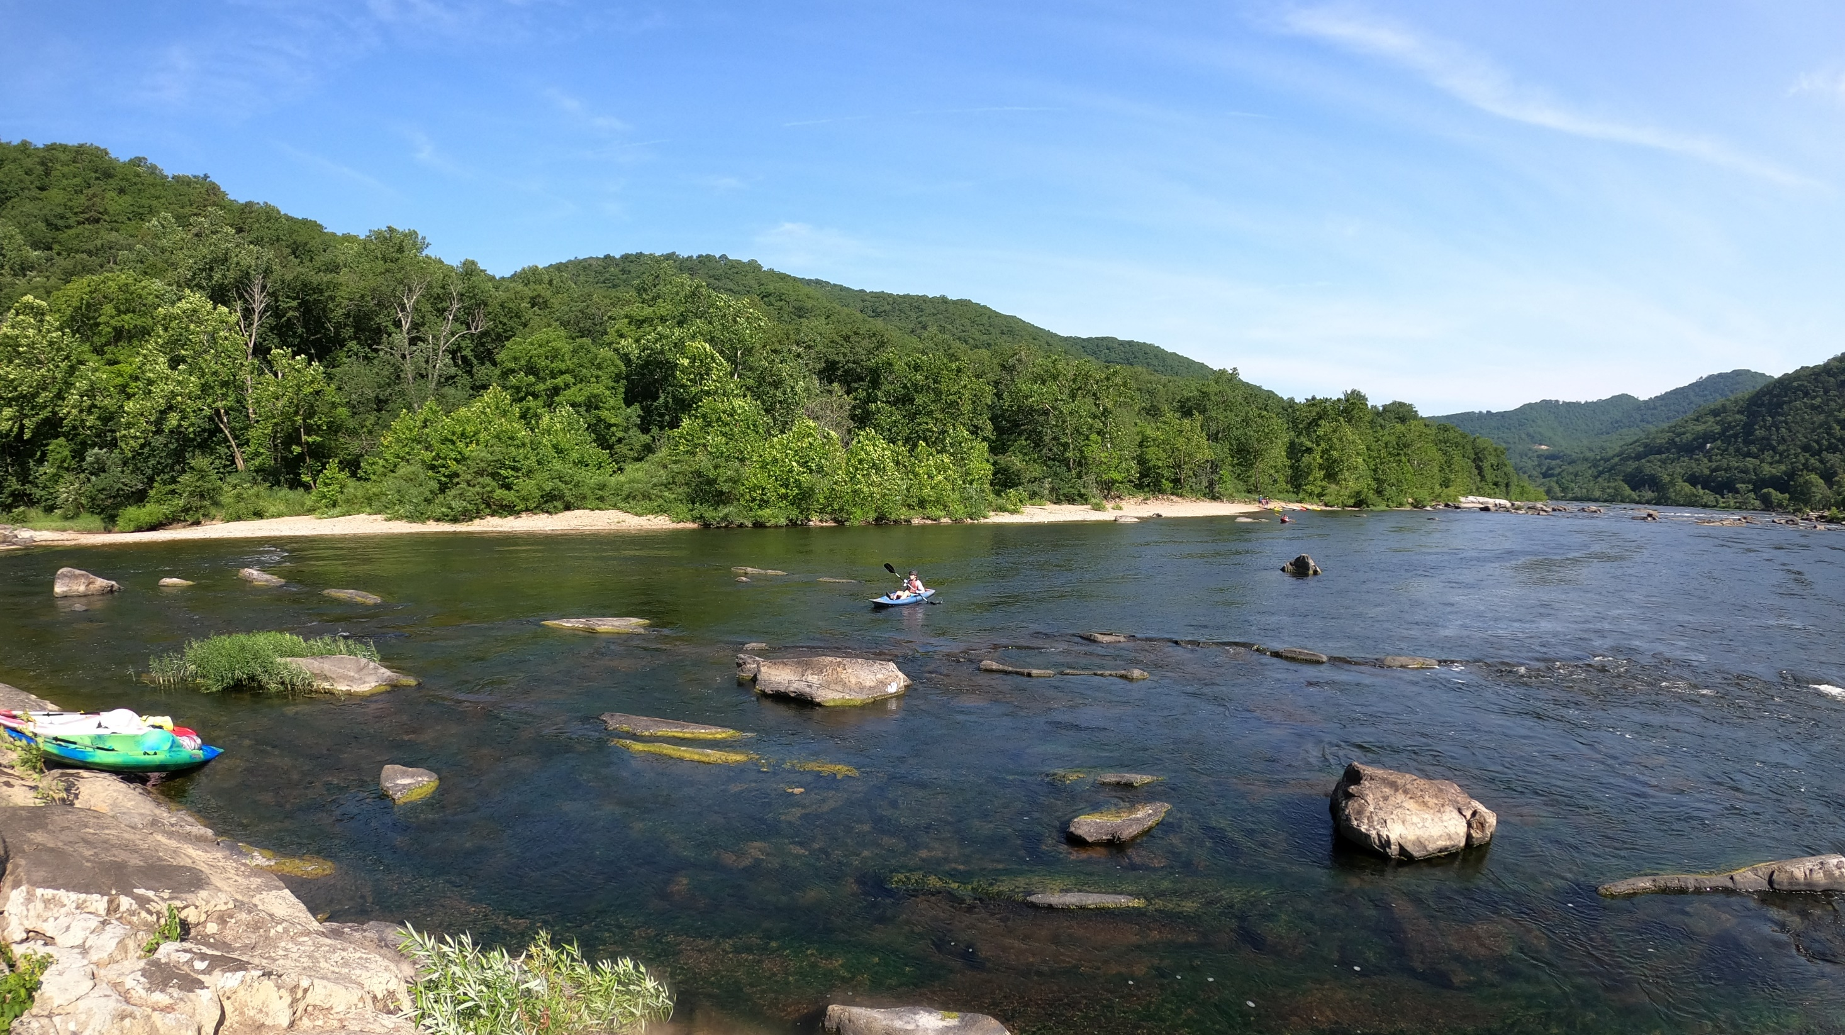
Scout Rock
Chris Wilson, Crew 893, Centreville VA

Slide 23
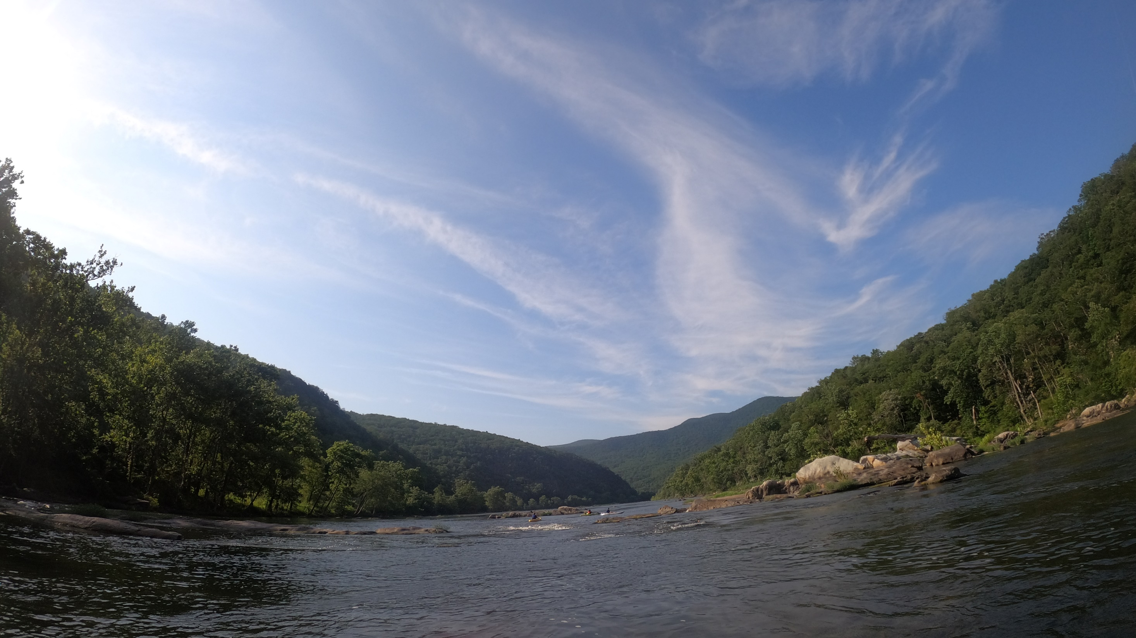
James River
Chris Wilson, Crew 893, Centreville VA

Slide 24
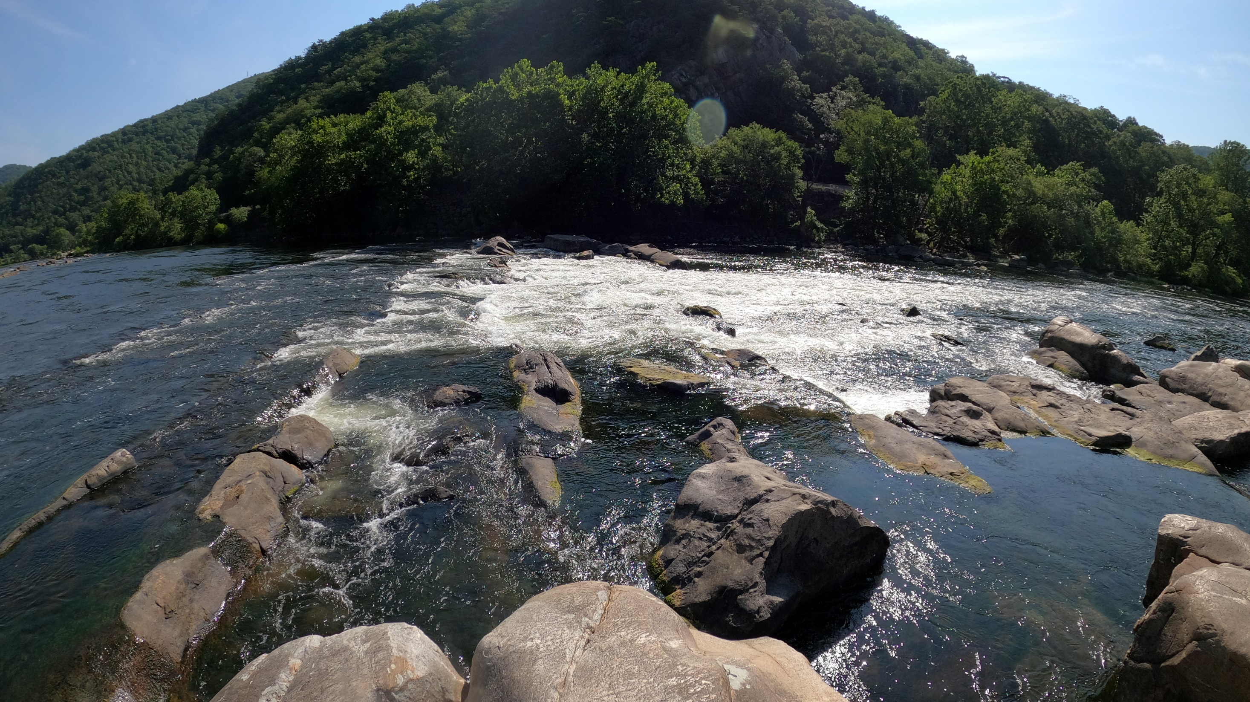
Balcony Falls
Chris Wilson, Crew 893, Centreville VA

Slide 25
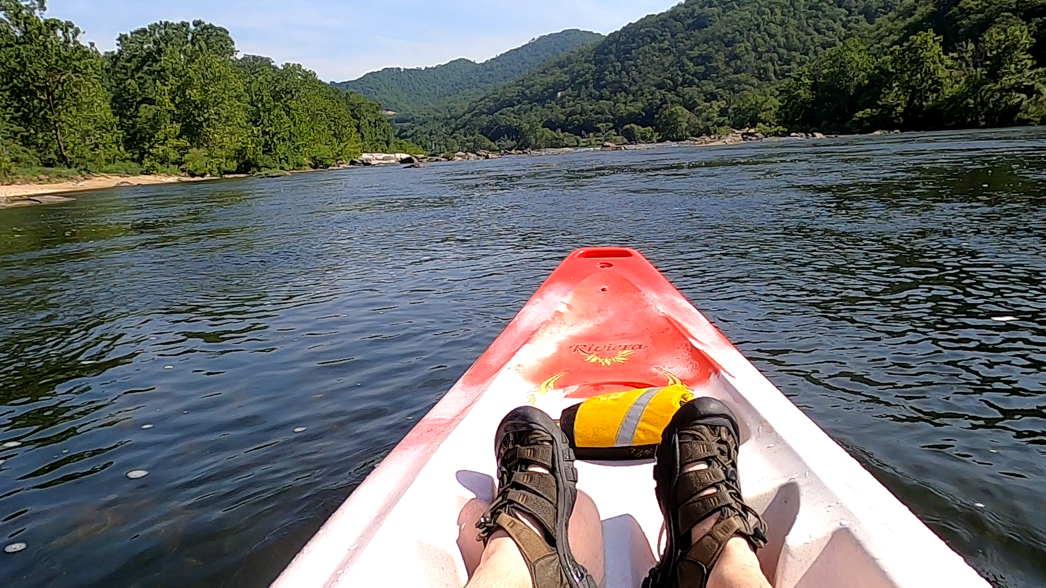
POV Balcony Falls
Chris Wilson, Crew 893, Centreville VA

Slide 26
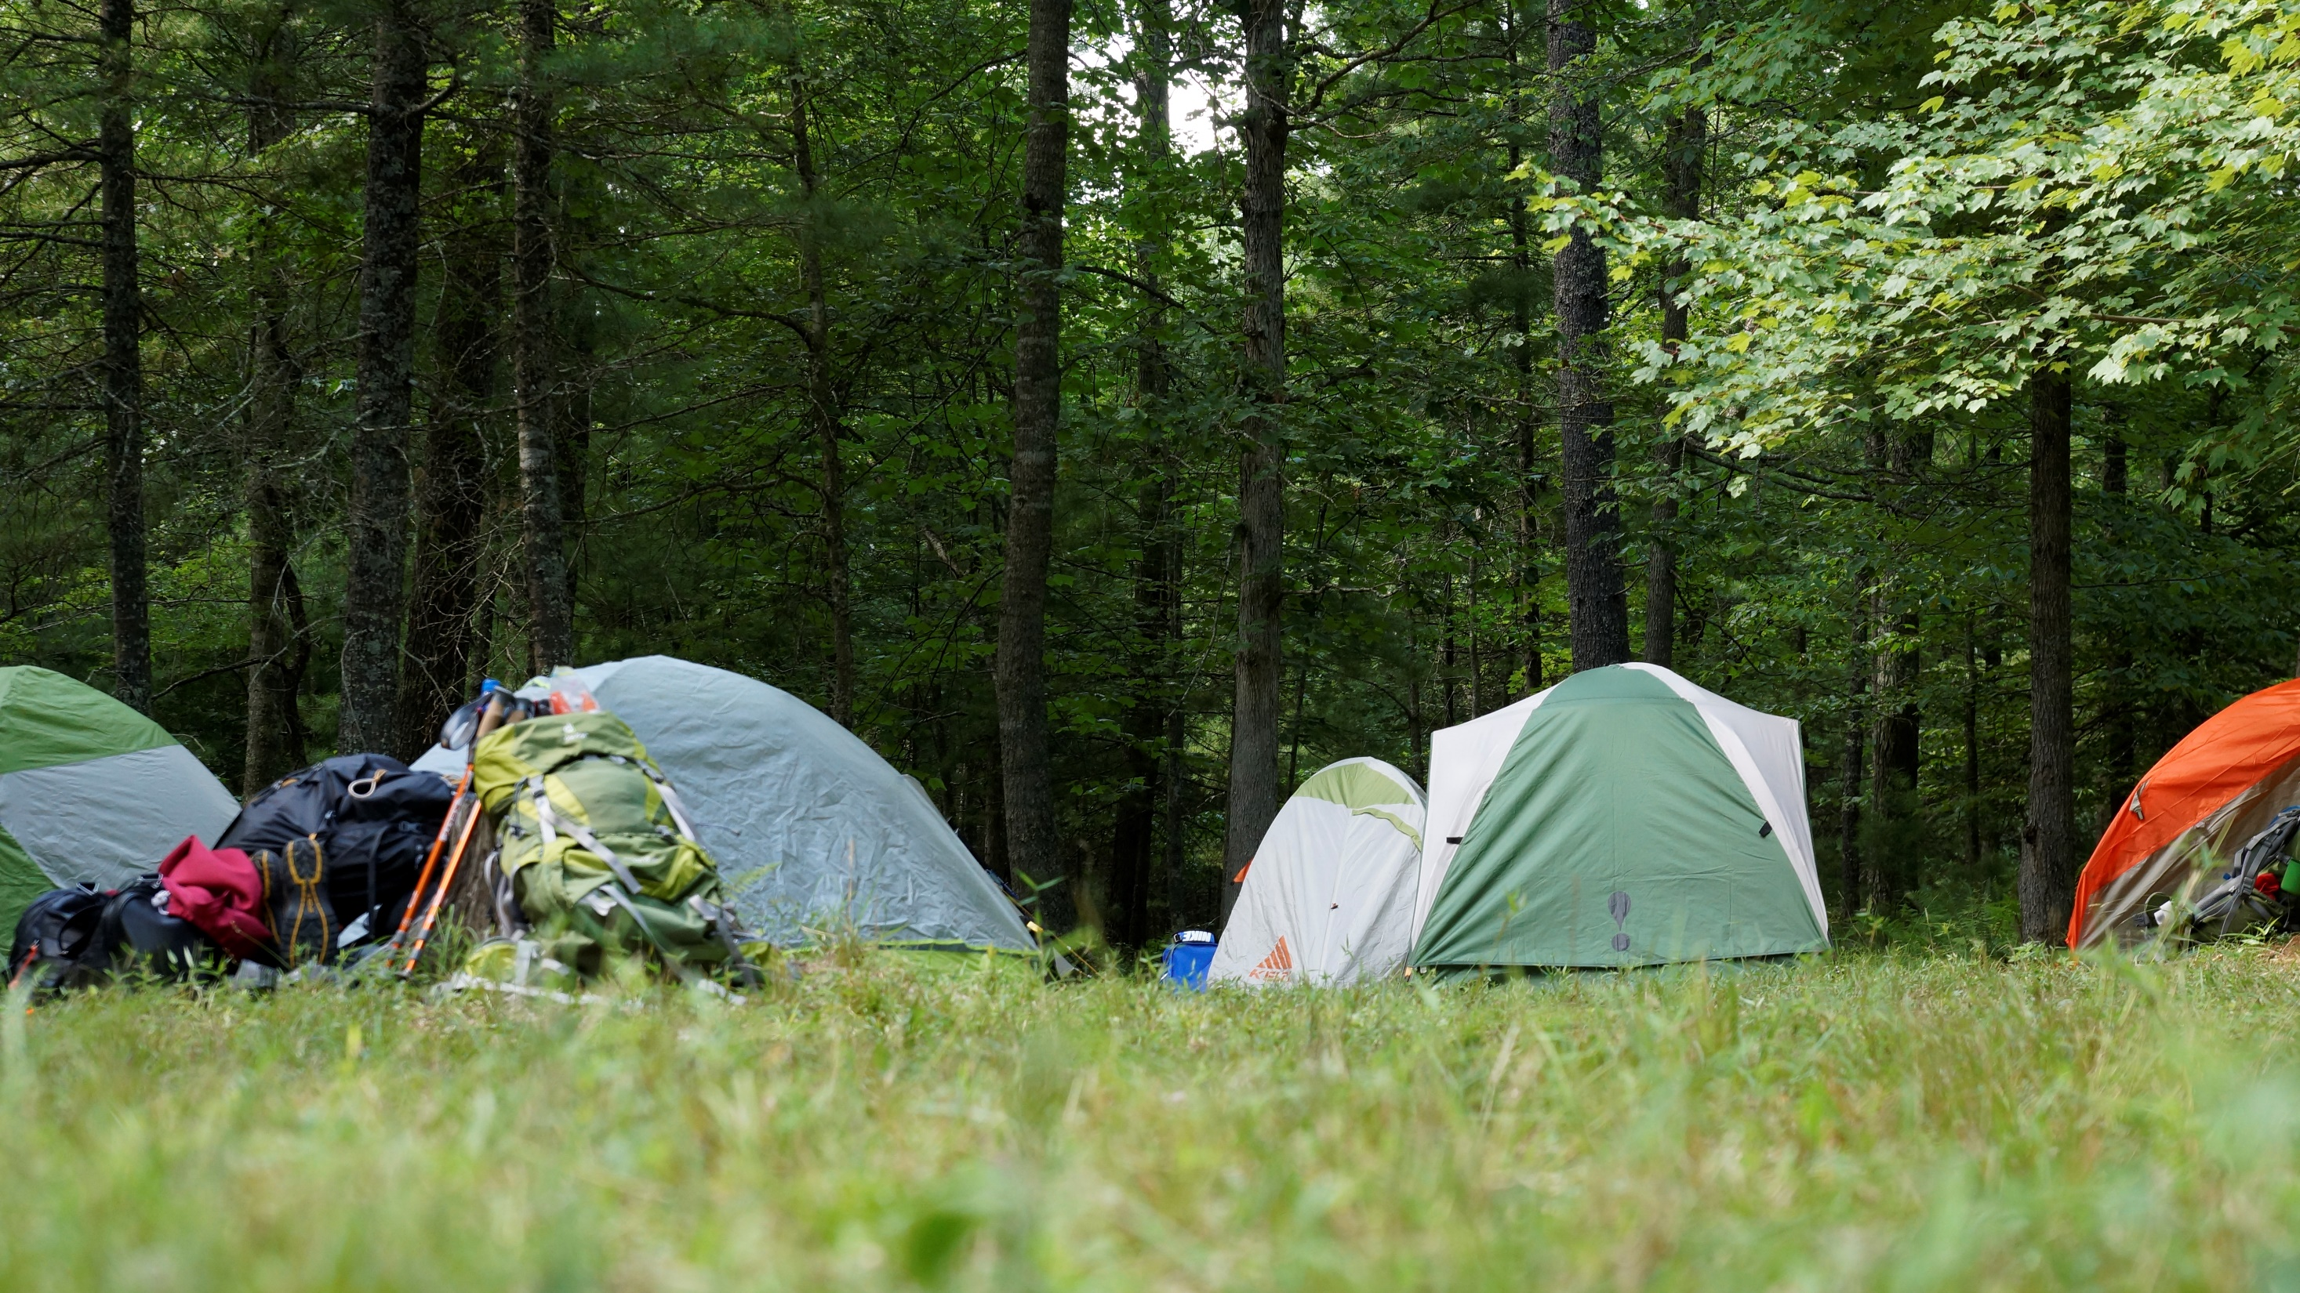
General Information

Slide 27
Participant Requirements
Participants must be 13 by September 1, 2022
Crew size:
  Minimum (Backpacking): 6 participants (at least two adults)
  Minimum (Canoeing): 8 participants (at least two adults)
  Maximum: 12 participants (at least two adults)
Completed BSA Medical Parts A, B, and C
  And NCAC Health Advisory

Slide 28
Training Requirements
Backpacking Trek
Canoe Trek
All Adults must have
  YPT Certification
One or more crew members must have:
+ Wilderness First Aid
+ CPR
+ Weather Hazards Training
+ Safe Swim Defense
All Adults must have:
  Youth Protection Training
One or more crew members must have:
+ Wilderness First Aid
+ CPR
+ Weather Hazards Training
+ Safe Swim Defense
+ Safety Afloat
+ Aquatics Supervision: Paddle Craft Safety - Basic

Slide 29
Trail Menu
Meals provided – Sunday Dinner through Saturday Breakfast
Mountain House Supplier
Allergy Accommodations
  Vegetarian Menu
  Encourage those with dietary restrictions to bring supplemental food
2022 Menu available soon!

Slide 30




BSA National
HIGH ADVENTURE BASES

Slide 31
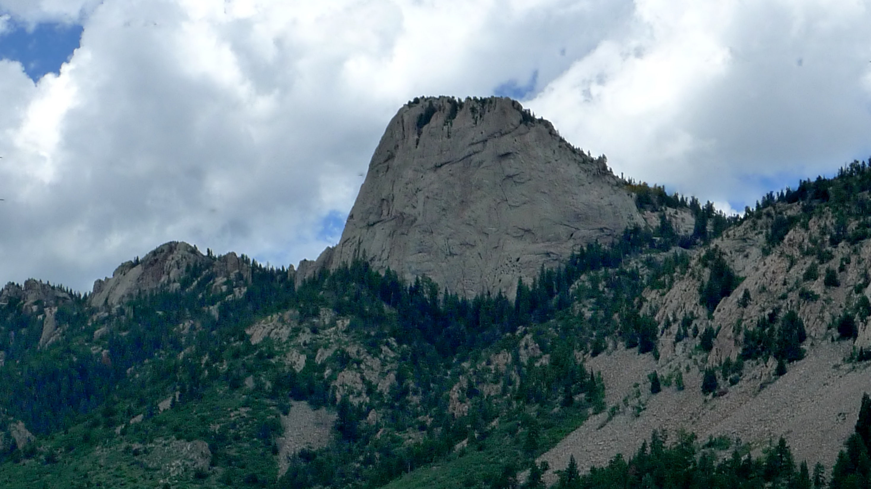

Philmont
“Largest Youth Camp … in the World”
Experienced by largest number of scouts
Unique BSA combination of backpacking & programs
Wide range of challenges for scouts 14 and up
Elevations up to 12,441 ft = low humidity & few bugs

Slide 32
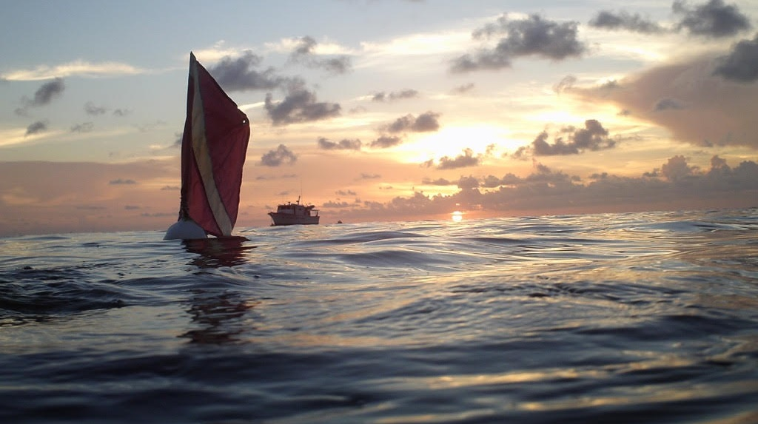
Sea Base
Most variety of program of any Nat’l HAB
All programs in Atlantic Ocean
Sailing & Snorkeling
SCUBA from land base or live-aboard boat
STEM programs
Out Island camping
Florida Keys, Bahamas & US Virgin Islands

Slide 33
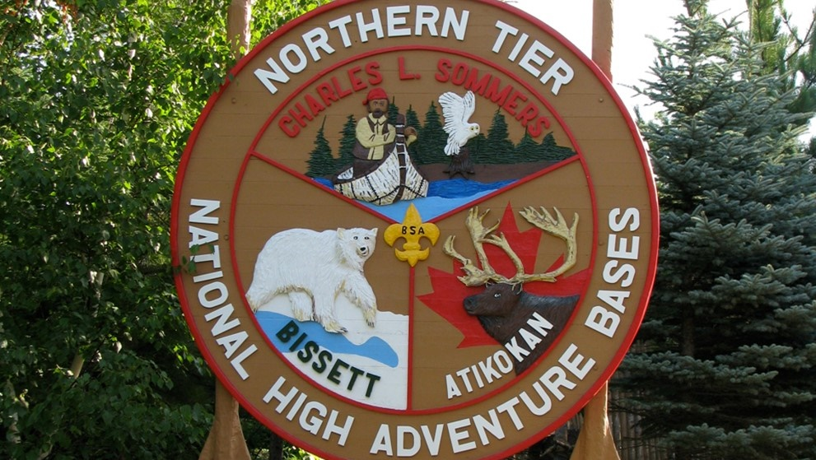
Northern Tier
Oldest National High Adventure Base (100th Anniversary)
Operates from three locations into U.S. Boundary Waters Wilderness Area; Ontario’s Quetico Park and Crownlands; and Manitoba’s Atikaki Wilderness Park
Provides true wilderness experience
NCAC High Adventure Committee recommends 10-day treks in late July by oldest scouts to get best experience

Slide 34
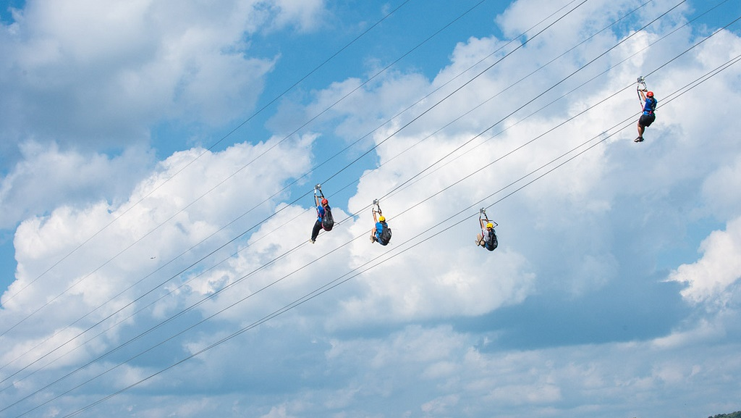
Summit Bechtel Reserve
Newest National Base, also used for Jamboree
Varied modern programs include:
  Mountain biking
  Skateboard park
  Giant zip line
  ATVs
As well as more traditional activities:
  Whitewater rafting
  Shooting sports
  Climbing

Slide 35
What is High Adventure?
Multi-day (5-6 or more) excursions
Usually change camp sites most nights
More challenging environment
Pack much lighter since you carry everything
Inside the BSA ”Safety Net” or “DIY”

Slide 36
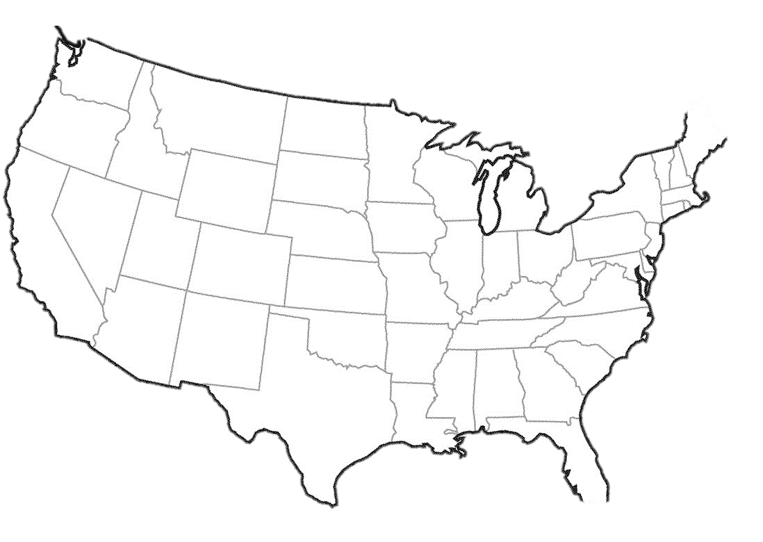








Where is BSA High Adventure?

Slide 37
Ways to Go on a High Adventure
With your Unit
Through Council-run Contingent Crews
As an Individual

Slide 38
High Adventure w/Council Crews
Roughly half of NCAC units lack the “critical mass” to conduct their own High Adventure trek due to:
  Current Lack of Scouts in Age Appropriate Groups
  Limited Adult Leader HA Experience & Knowledge
NCAC HAC “Contingent”/”Provisional” treks
  Accept small groups or individuals from these Units
  Units can then “leave the nest” after one or more HAC treks
NCAC HAC handles all planning & logistics

Slide 39
Council Crews, continued
NCAC HAC Training Sessions for
  Philmont
  Northern Tier
  Sea Base
Philmont Adult Advisor Hike (mandatory for HAC treks)
Adult Advisors & Crew Leaders from any NCAC crew are always welcome at any NCAC HAC training!

Slide 40
Provisional Units – James River Canoe Trek
Sponsored by the High Adventure Committee
For individual Scouts (of all branches) ages 14+
Week 4 Session: July 17-23, 2022
Learn more on the HAC and/or Lenhok’sin webpages

Slide 41







High Adventure Progression - “Ages & Stages”
13 14 15 16 17 18

Slide 42
High Adventure Bases – 2022 Season Possible Protocols
All four National Bases plan to open – fully or partially
Participant screening (before departure, upon arrival)
Each Crew remains together as a cohort
Masks, social distancing may be required in basecamp, program areas
WFA/CPR trained crewmember(s) still required
Sea Base participants required to have own mask, fins, snorkel

Slide 43
High Adventure Bases – 2022 Availability!
Philmont
  12-day, 9-day and 7-day Crew Treks – limited openings
  Individual Treks (Trail Crew, OA Trail Crew, Rayado, ROCS, Ranch Hands, STEM)
Sea Base
  Coral Reef Sailing, Key West Sailing, Marine STEM, Out Island Adventure, SCUBA Adventure, SCUBA Live Aboard, St. Croix Adventure, St. Croix SCUBA, St. Croix Eco STEM Adventure
Northern Tier
  Ely Base, Bisset – limited dates
Summit
  Good availability: New River, Summit, Bikepacking, ATV, Marksman, Pack n’ Paddle

Slide 44
Resources – High Adventure Bases
Philmont: www.philmontscoutranch.org/
Sea Base: www.bsaseabase.org
Northern Tier: www.ntier.org/
Summit: www.summitbsa.org/
OPEN4ADVENTURE: www.scouting.org/outdooradventures/open4adventure/

Slide 45

YiHA (Yours in High Adventure) !!
NCAC High Adventure Committee
www.ncacbsa.org/high-adventure/
highadventure@ncacbsa.org

Slide 46
Questions?

